Slide 1
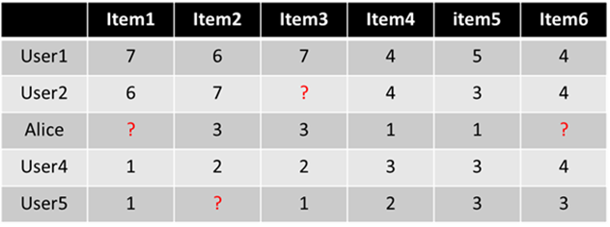
Latent factor models
Latent factor models are considered to be state-of-the-art in recommender systems.
These models leverage well-known dimensionality reduction methods to fill in the miss entries.

Slide 2
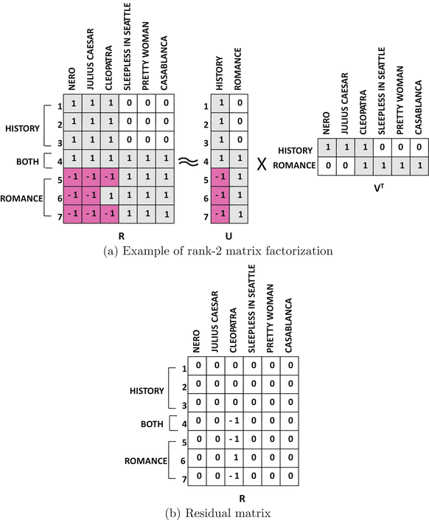
The key idea is that any m × n matrix R of rank k ≪ min{m, n} can always be expressed in the following product form of rank-k factors
R=UV^{T}
U is an m × k matrix, and V is an n × k matrix

Slide 3
The error of this approximation
is equal to ||R − UV^{T}||²
Note
The matrix entries in the factors are typically real numbers (rather than integral).
A neat semantic interpretation of the factors in terms of genres or categories is sometimes not possible

Slide 4
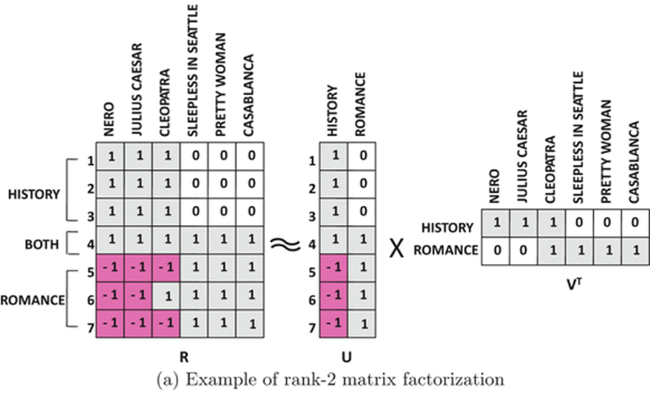
Latent vector
Latent component

Slide 5
item factor
user factor

Slide 6
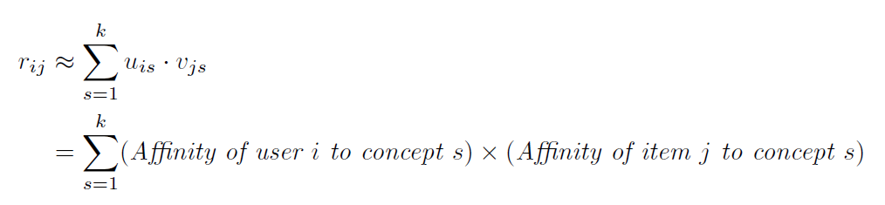

Slide 8
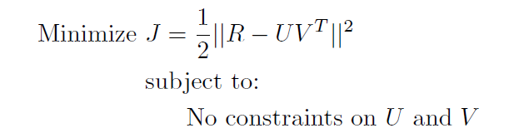
Unconstrained Matrix Factorization
Minimize the error of this approximation
||R − UV^{T}||²
The smaller the objective function is, the better the quality of the factorization R ≈ UV^{T} will be.
This objective function can be viewed as a quadratic loss function, which quantifies the loss of accuracy in estimating the matrix R with the use of low-rank factorization.

Slide 9
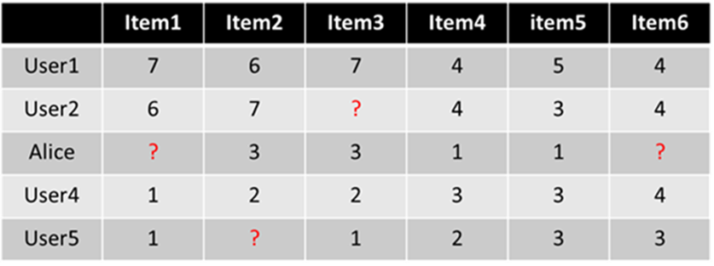
Unconstrained Matrix Factorization
In the context of a matrix with missing entries, only a subset of the entries of R are known.
Let the set of all user-item pairs (i, j), which are observed in R, be denoted by S.
i ∈ {1 . . .m} is the index of a user, and j ∈ {1 . . .n} is the index of an item.
S = {(i, j) : r_{ij} is observed}

Slide 10
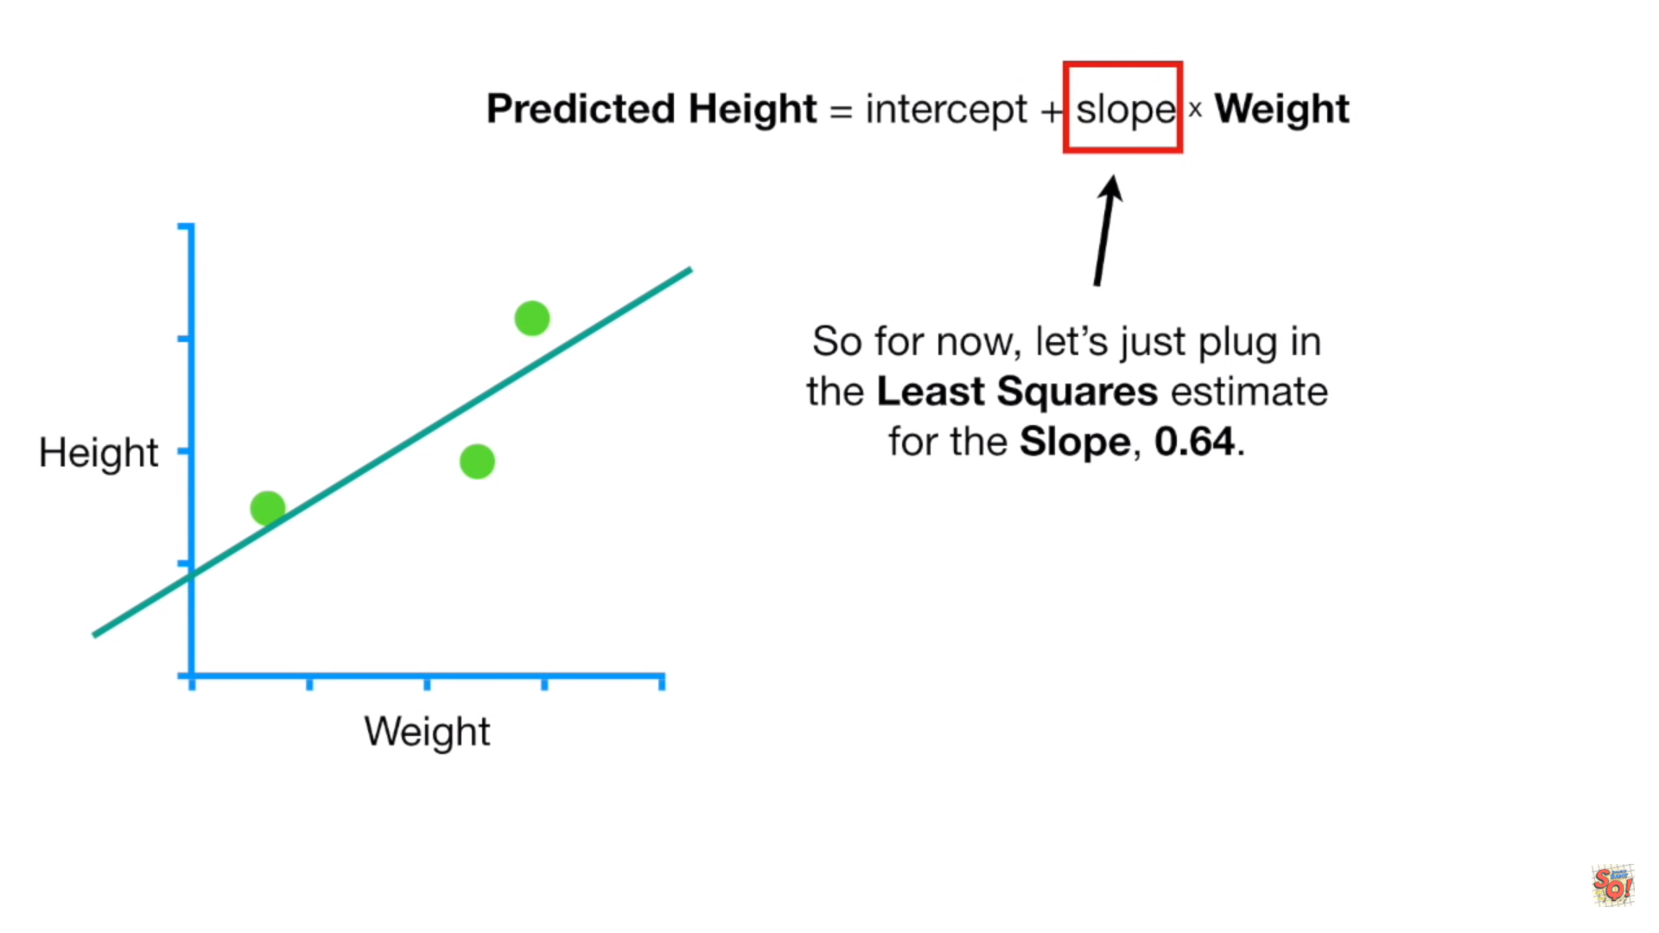
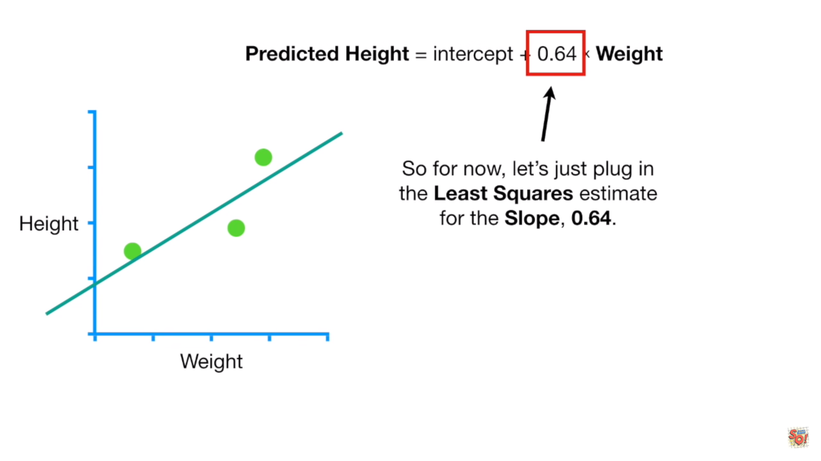
Gradient descent method

Slide 11
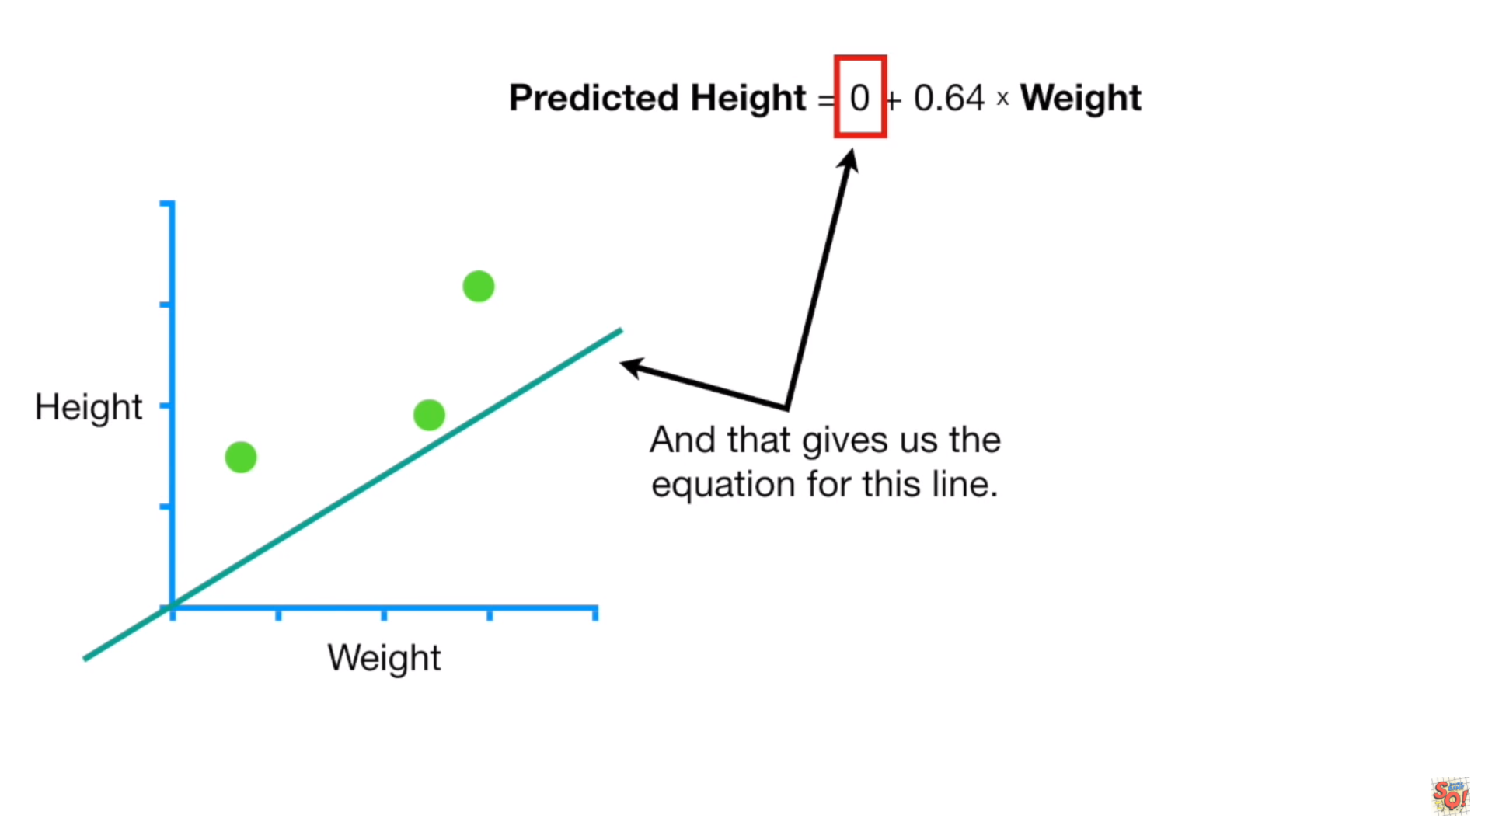
Generate the initial guess randomly.

Slide 12
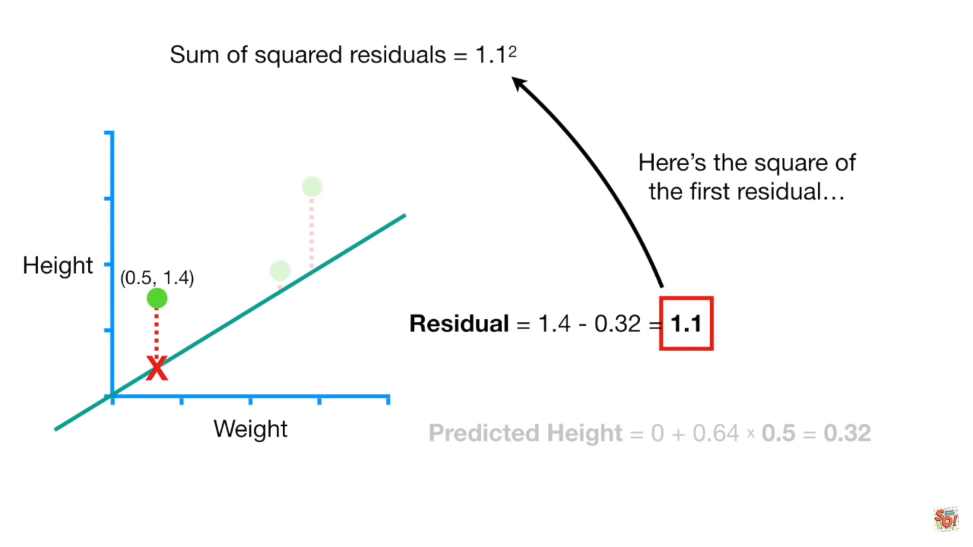

Slide 13
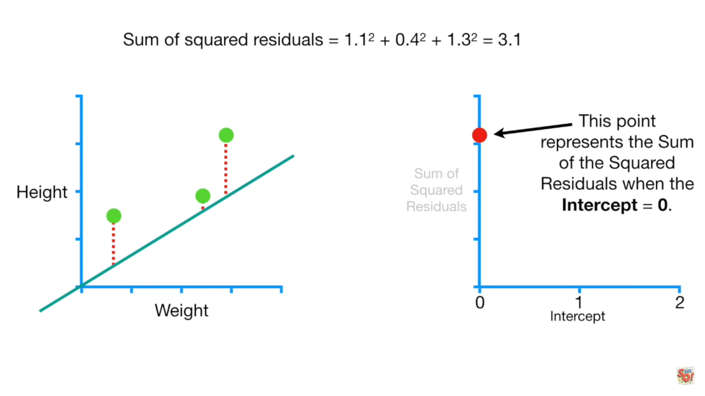

Slide 14
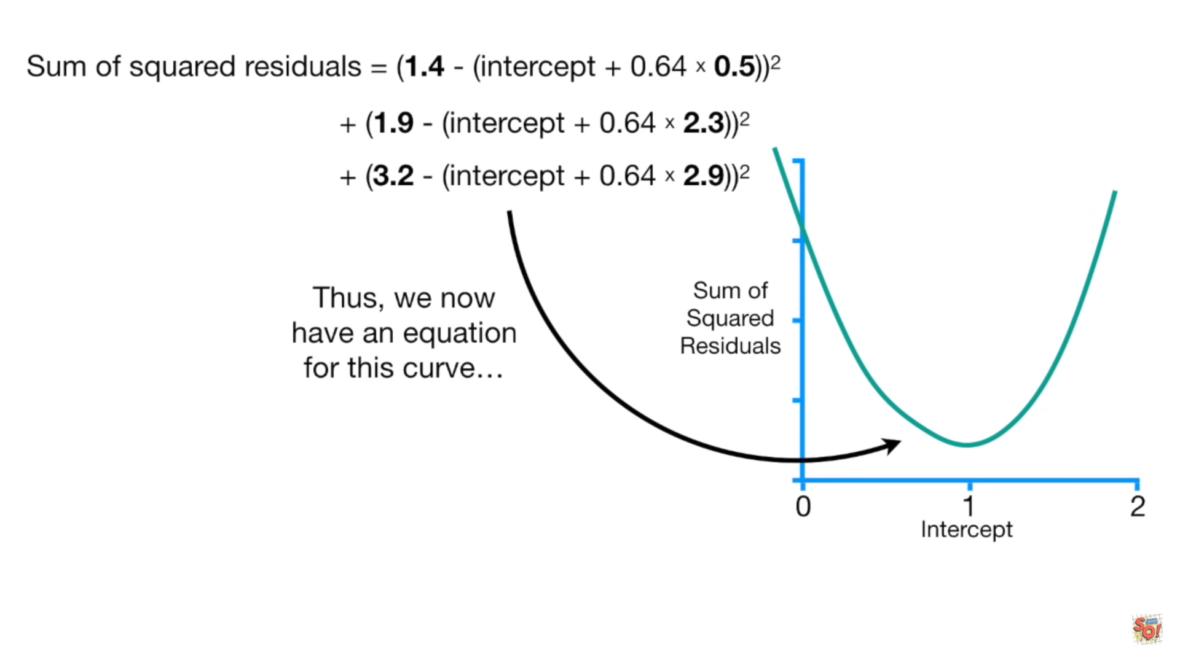

Slide 15
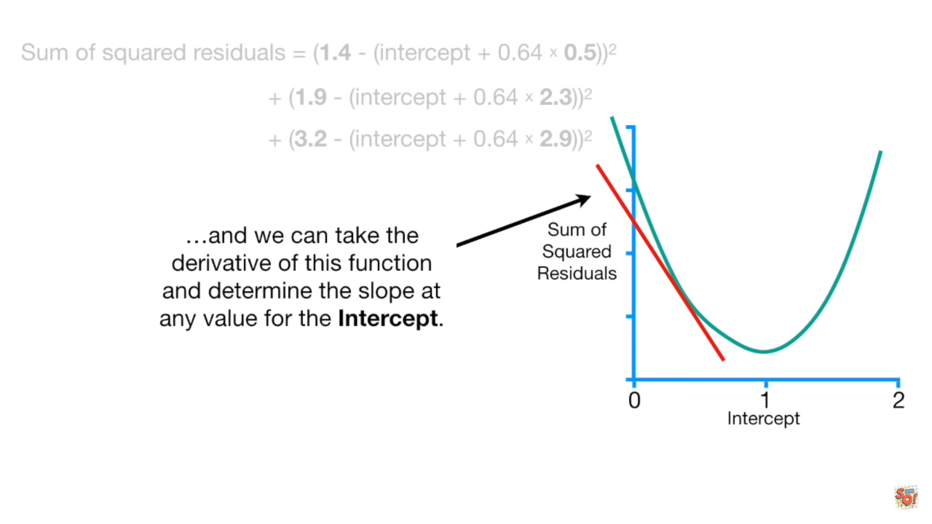

Slide 16
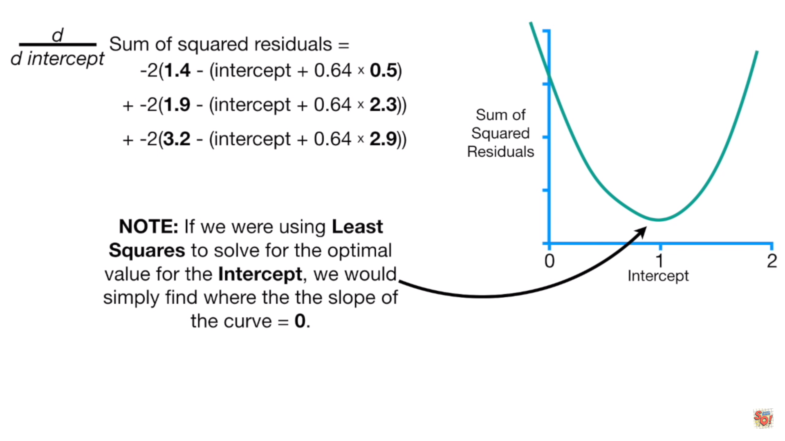
{(0.5, 1.4), (2.3, 1.9), (2.9, 3.2)}

Slide 17
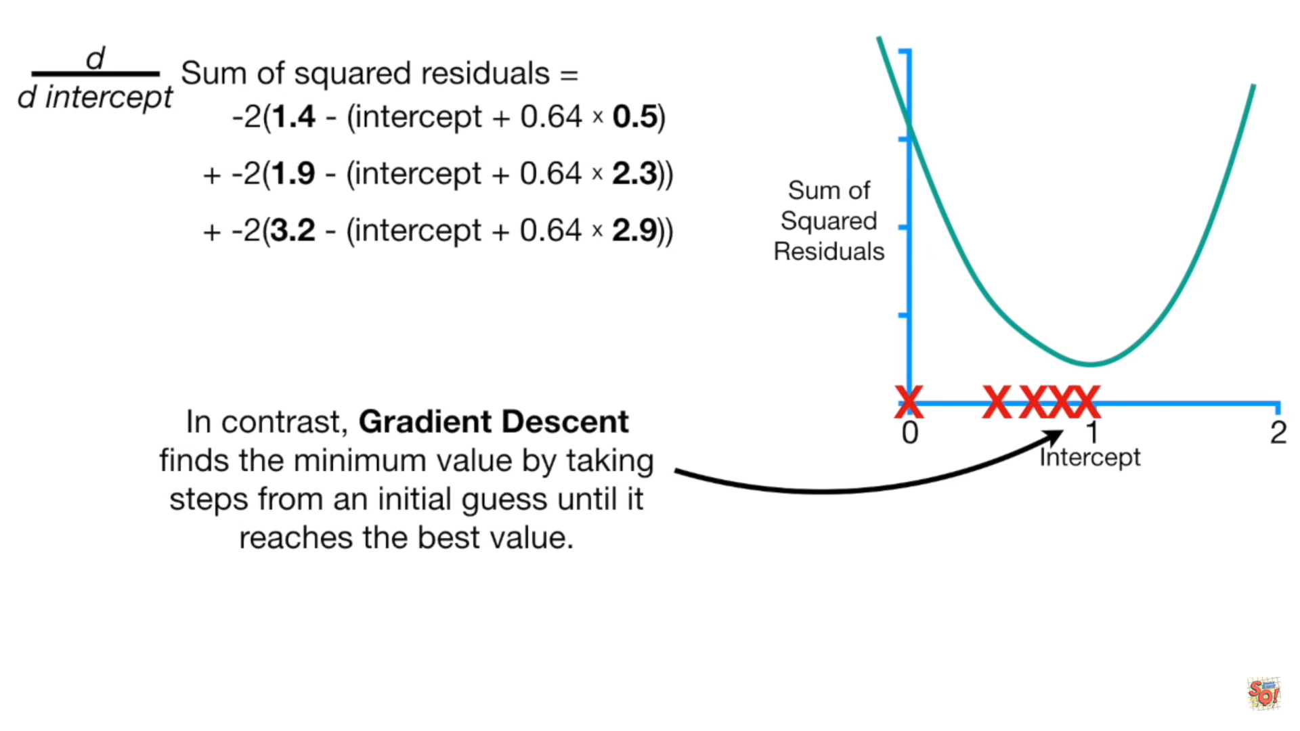

Slide 18
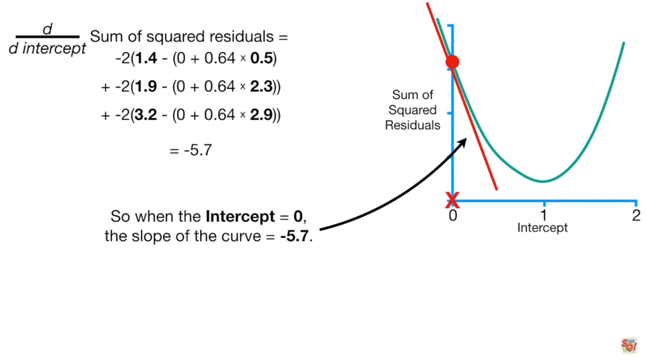
The size of the step should be related to the slope
Gradient descent
step size= slope * α
Learning rate

Slide 19
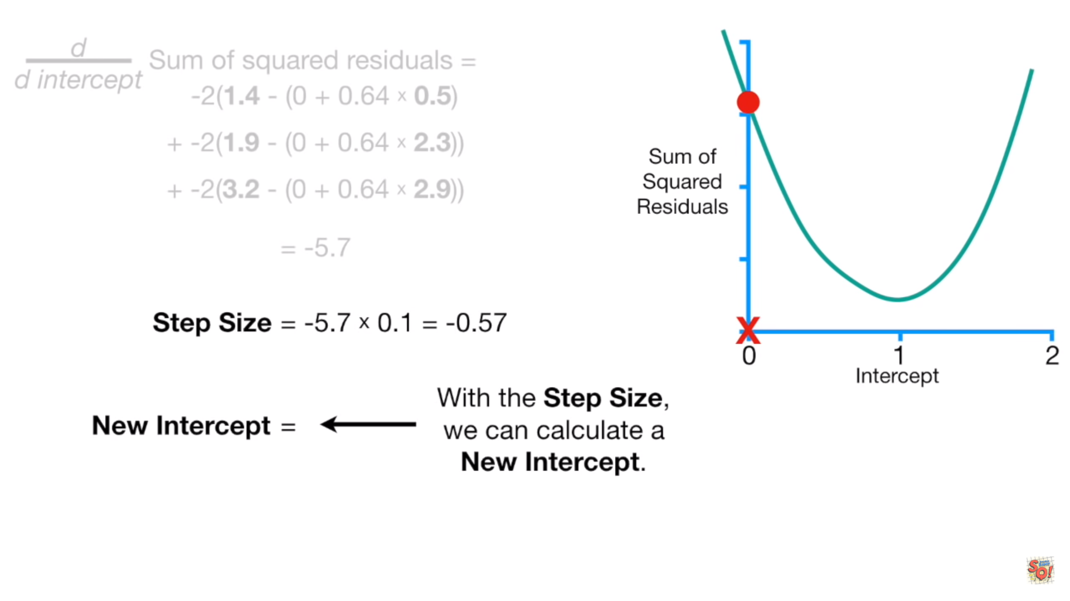
New intercept=old intercept – step size
0-(-0.57)=0.57

Slide 20
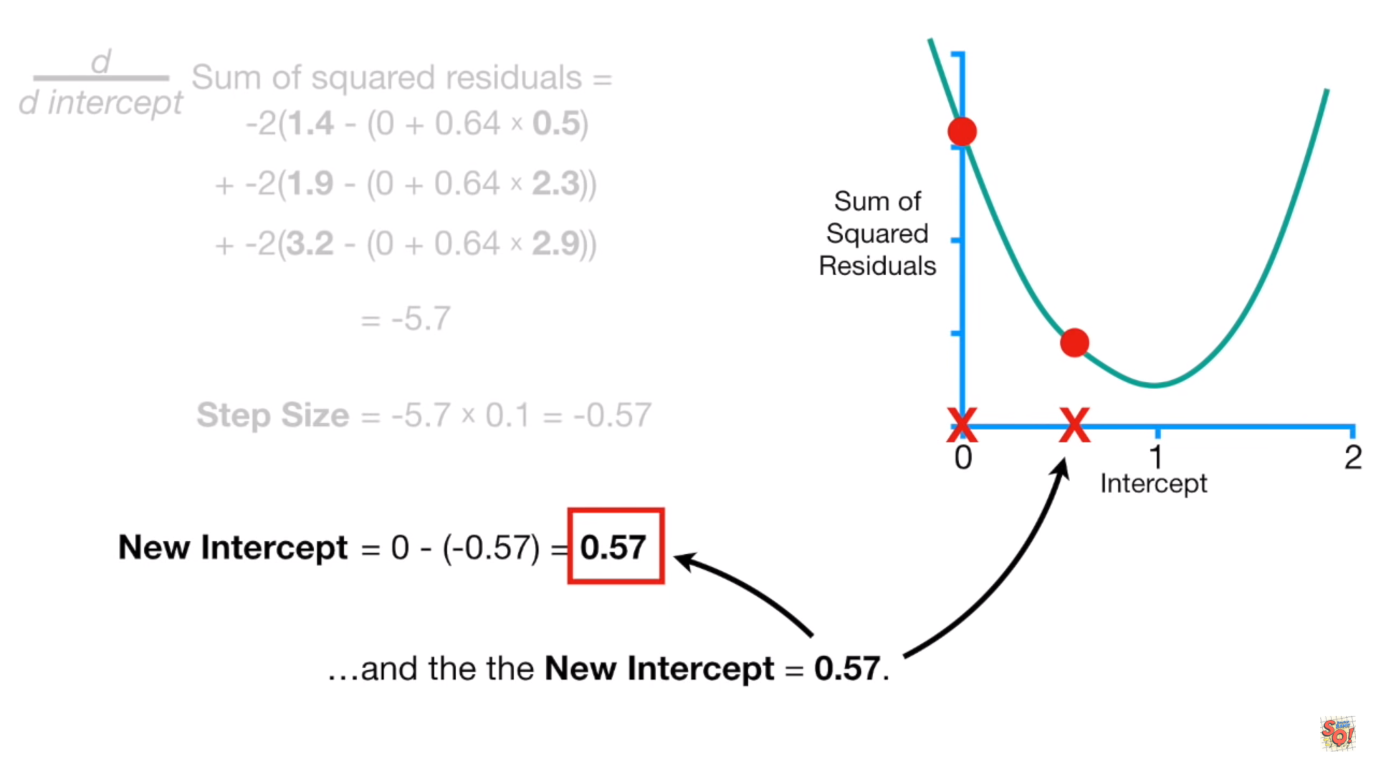

Slide 21
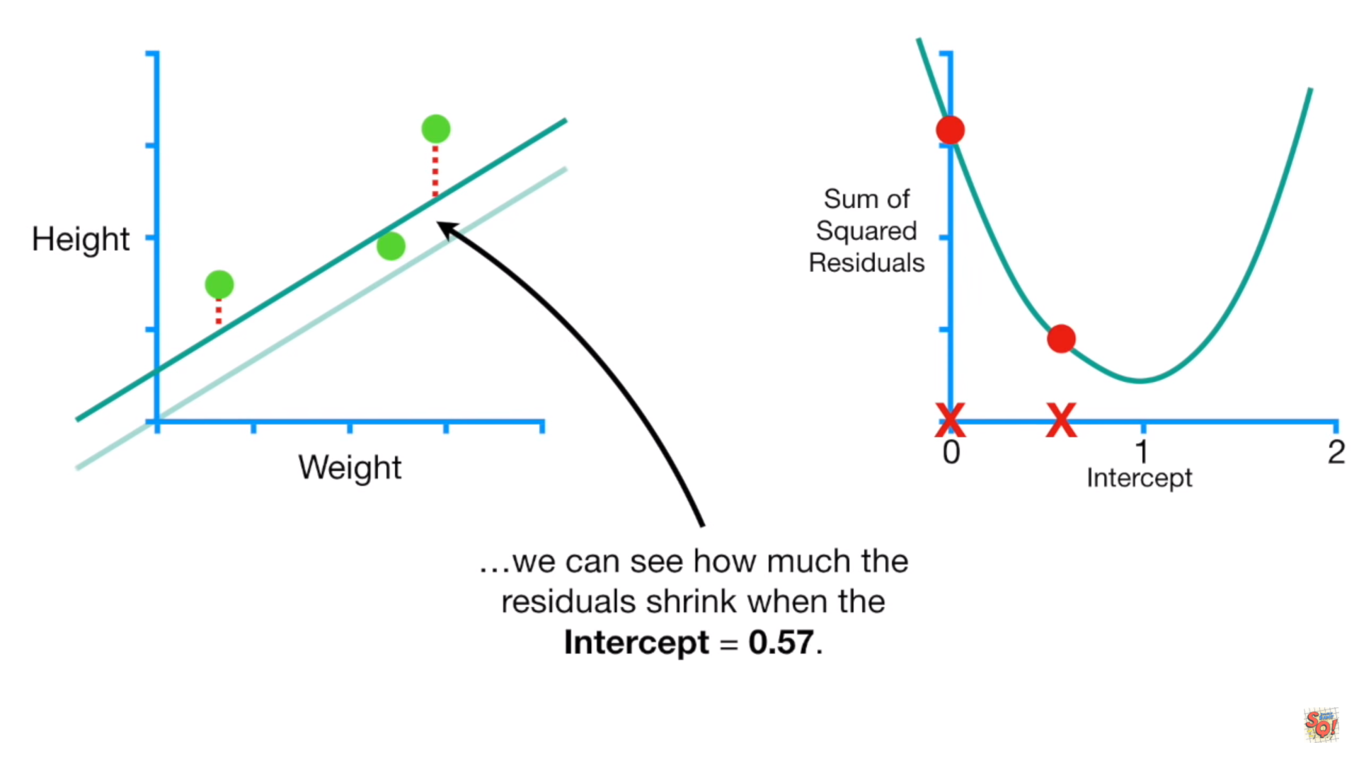

Slide 22
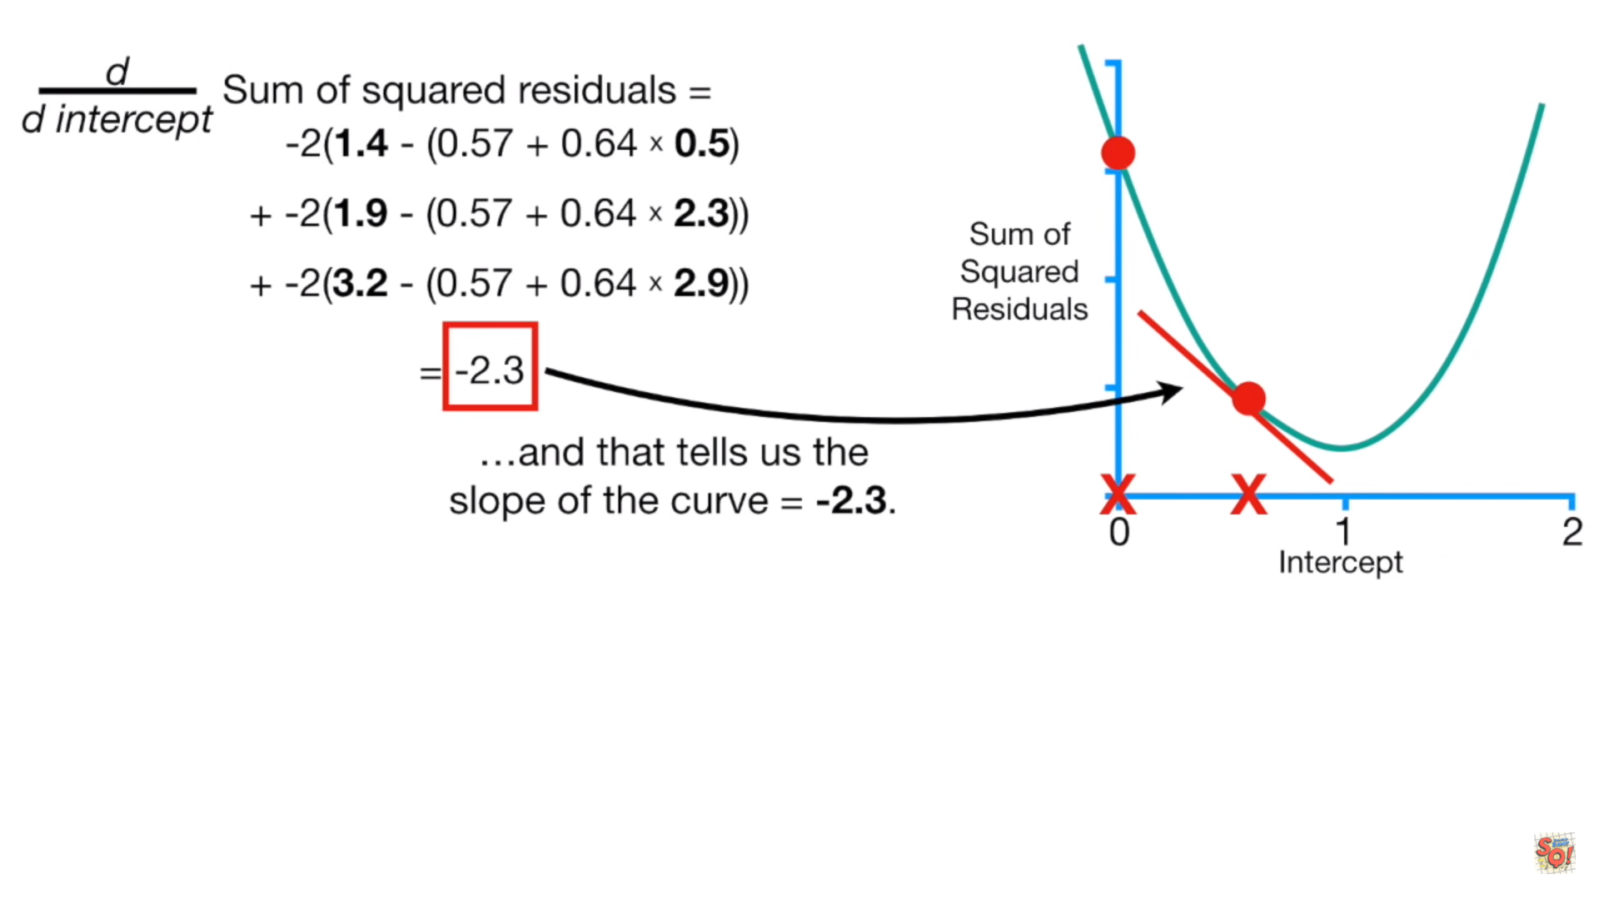
0.57
New intercept=old intercept – step size
Step size=-2.3*0.1=-0.23
New intercept=0.57-(-0.23)=0.8

Slide 23
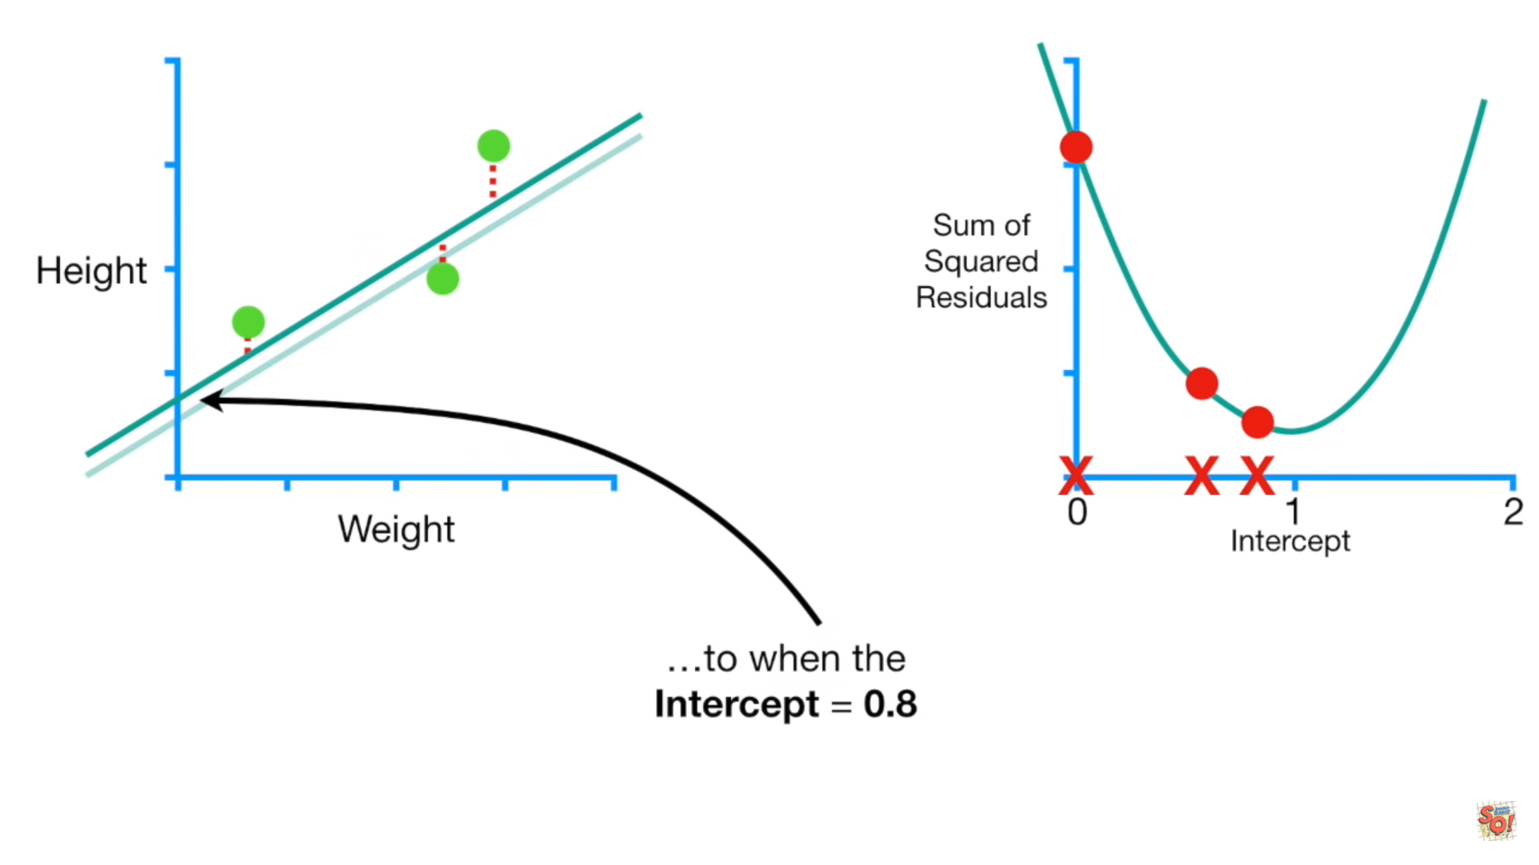

Slide 24
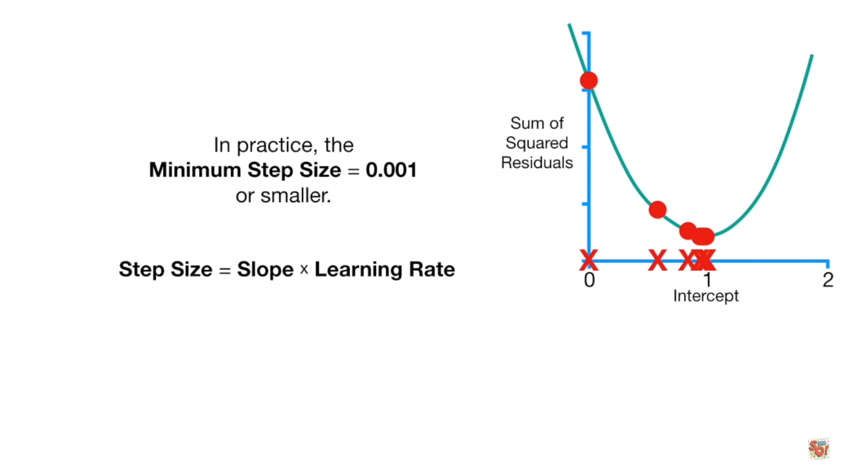
Stop when slope is very close to zero

Slide 25
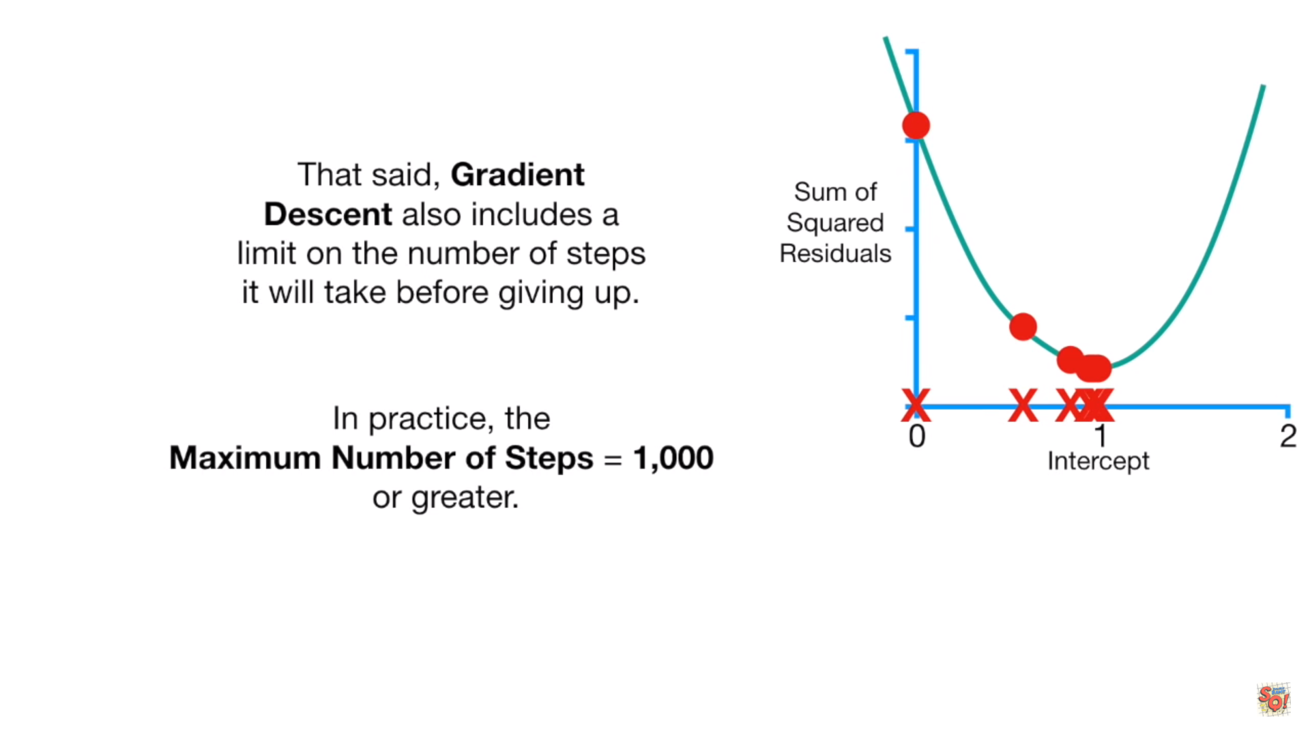

Slide 26
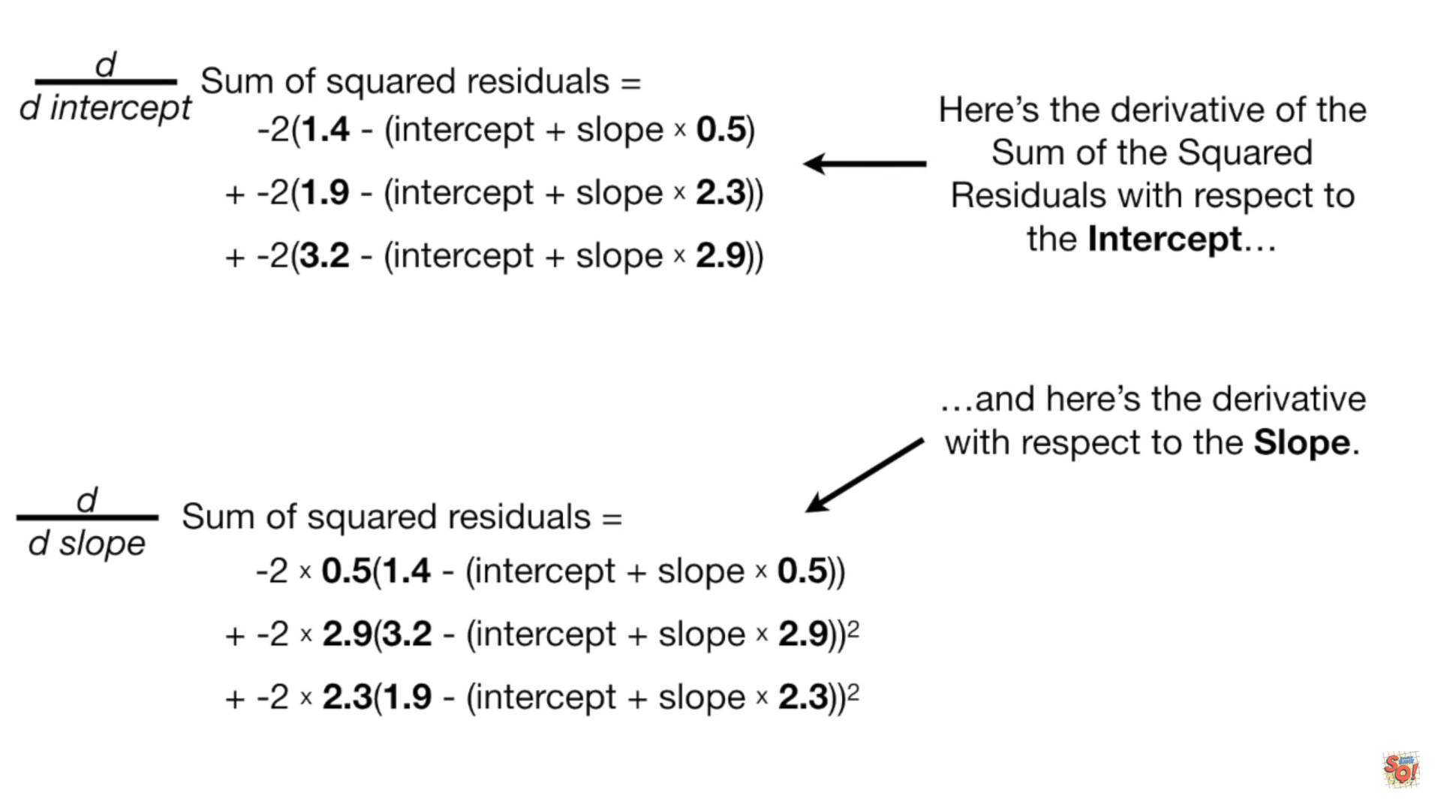
In the example, we have two variables
Compute the partial derivative of loss function with respect to the variables

Slide 27
Gradient descent methods

Slide 28

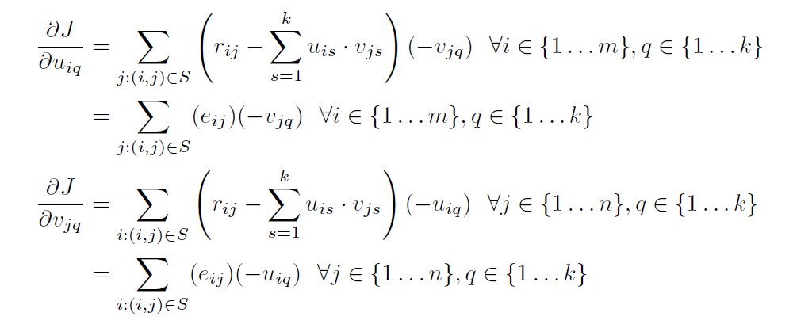
Gradient descent methods

Slide 29
Example
Item
1 | 2 | ? | 1
? | 2 | 0 | ?
2 | 3 | ? | 1
? | 5 | 2 | ?
2 | ? | 4 | 0
U₁₁ | U₁₂
U₂₁ | U₂₂
U₃₁ | U₃₂
U₄₁ | U₄₂
U₅₁ | U₅₂
V₁₁ | V₁₂
V₂₁ | V₂₂
V₃₁ | V₃₂
V₄₁ | V₄₂
User
V
U
V^{T}
U

Slide 30
Item
1 | 2 | ? | 1
? | 2 | 0 | ?
2 | 3 | ? | 1
? | 5 | 2 | ?
2 | ? | 4 | 0
U₁₁ | U₁₂
U₂₁ | U₂₂
U₃₁ | U₃₂
U₄₁ | U₄₂
U₅₁ | U₅₂
V₁₁ | V₁₂
V₂₁ | V₂₂
V₃₁ | V₃₂
V₄₁ | V₄₂
User
V
U
v

Slide 31
Item
U₁₁ | U₁₂
U₂₁ | U₂₂
U₃₁ | U₃₂
U₄₁ | U₄₂
U₅₁ | U₅₂
1 | 2 | ? | 1
? | 2 | 0 | ?
2 | 3 | ? | 1
? | 5 | 2 | ?
2 | ? | 4 | 0
v₁₁ | v₂₁ | v₃₁ | v₄₁
v₁₂ | v₂₂ | v₃₂ | v₄₂
User
V^{T}
U

Slide 32
Item
U₁₁ | U₁₂
U₂₁ | U₂₂
U₃₁ | U₃₂
U₄₁ | U₄₂
U₅₁ | U₅₂
1 | 2 | ? | 1
? | 2 | 0 | ?
2 | 3 | ? | 1
? | 5 | 2 | ?
2 | ? | 4 | 0
v₁₁ | v₂₁ | v₃₁ | v₄₁
v₁₂ | v₂₂ | v₃₂ | v₄₂
User
V^{T}
U

Slide 33
Item
U₁₁ | U₁₂
U₂₁ | U₂₂
U₃₁ | U₃₂
U₄₁ | U₄₂
U₅₁ | U₅₂
1 | 2 | ? | 1
? | 2 | 0 | ?
2 | 3 | ? | 1
? | 5 | 2 | ?
2 | ? | 4 | 0
v₁₁ | v₂₁ | v₃₁ | v₄₁
v₁₂ | v₂₂ | v₃₂ | v₄₂
User
V^{T}
U

Slide 34
Item
U₁₁ | U₁₂
U₂₁ | U₂₂
U₃₁ | U₃₂
U₄₁ | U₄₂
U₅₁ | U₅₂
1 | 2 | ? | 1
? | 2 | 0 | ?
2 | 3 | ? | 1
? | 5 | 2 | ?
2 | ? | 4 | 0
v₁₁ | v₂₁ | v₃₁ | v₄₁
v₁₂ | v₂₂ | v₃₂ | v₄₂
User
V^{T}
U

Slide 35
Item
Initial guess
1 | 2 | ? | 1
? | 2 | 0 | ?
2 | 3 | ? | 1
? | 5 | 2 | ?
2 | ? | 4 | 0
1 | 1
1 | 1
1 | 1
1 | 1
1 | 1
1 | 1 | 1 | 1
1 | 1 | 1 | 1
User
V^{T}
U
α=0.01 => step size=2*0.01=0.02
u₁₁ <= 1-0.02=0.98

Slide 36
Item
Assume
1 | 2 | ? | 1
? | 2 | 0 | ?
2 | 3 | ? | 1
? | 5 | 2 | ?
2 | ? | 4 | 0
1 | 0
1 | 0
1 | 1
2 | 1
0 | 2
1 | 2 | 0 | 1
1 | 1 | 2 | 0
User
V^{T}
U
1 | 2 | 0 | 1
1 | 2 | 0 | 1
2 | 3 | 2 | 1
3 | 5 | 2 | 2
2 | 2 | 4 | 0

Slide 37
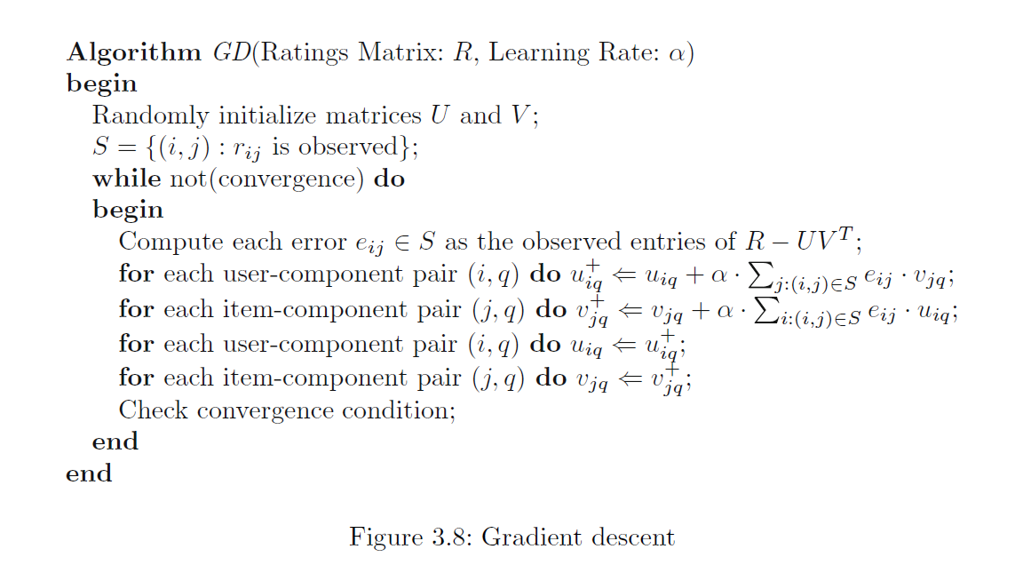
Gradient descent methods
The intermediate variables u_{iq}⁺ and v_{jq}⁺ are used to ensure that all updates to the entries in U and V are performed simultaneously

Slide 38

Stochastic Gradient Descent
Gradient descent methods
We have 2 variables and 3 observations
It is common to take at least 1000 steps

Slide 39
Gradient descent methods
For big data, gradient descent is slow
We have m*k+n*k variables
We have a lot of observations

Slide 40
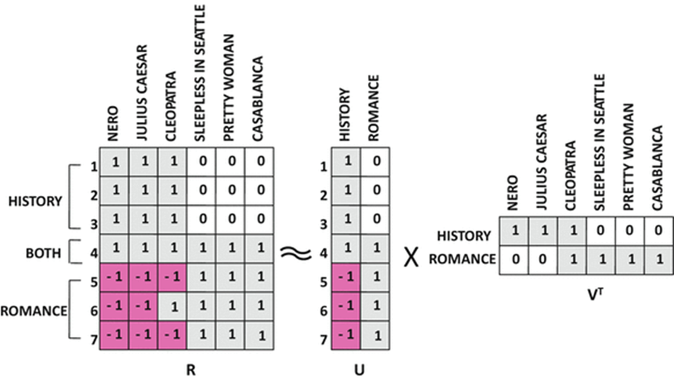
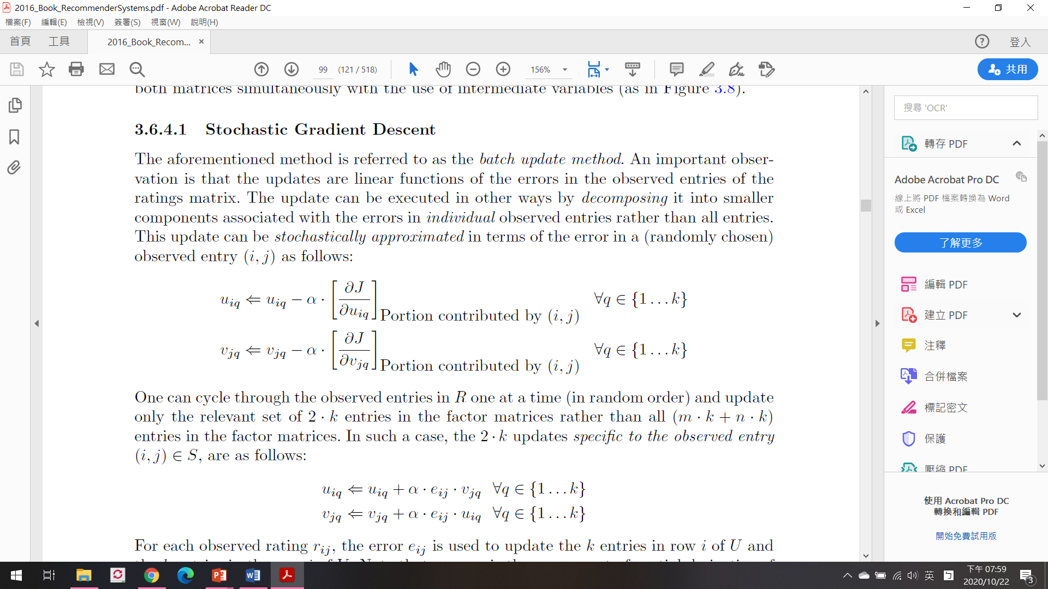
Stochastic Gradient Descent
Randomly pick one sample for each step
Use that one sample to calculate the derivatives.

Slide 41
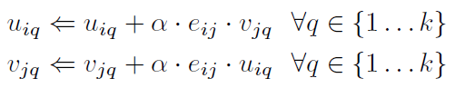
Stochastic Gradient Descent

Slide 42
Stochastic Gradient Descent
In general, stochastic gradient descent is preferable when the data size is very large and computational time is the primary bottleneck.
In other “compromise” methods, mini-batches are used in which a subset of observed entries is used to construct the update.
A typical value of the learning rate is a small constant value such as α = 0.005.

Slide 43
Regularization
One of the main problems with this approach arises when the ratings matrix R is sparse and relatively few entries are observed.
the observed set S of ratings is small, which can cause overfitting.
overfitting is also a common problem in classification when training data are limited.
A common approach for addressing this problem is to use regularization.
Regularization reduces the tendency of the model to overfit at the expense of introducing a bias in the model.

Slide 44
Regularization
A regularization term, (λ/2) (||U||² +||V ||²), is added to the objective function, where λ > 0 is the regularization parameter.
The idea is to discourage very large values of the coefficients in U and V in order to encourage stability.

Slide 45
Regularization
The basic idea is to create a bias in favor of simpler solutions by penalizing large coefficients
The parameter λ is always non-negative and it controls the weight of the regularization term.

Slide 46
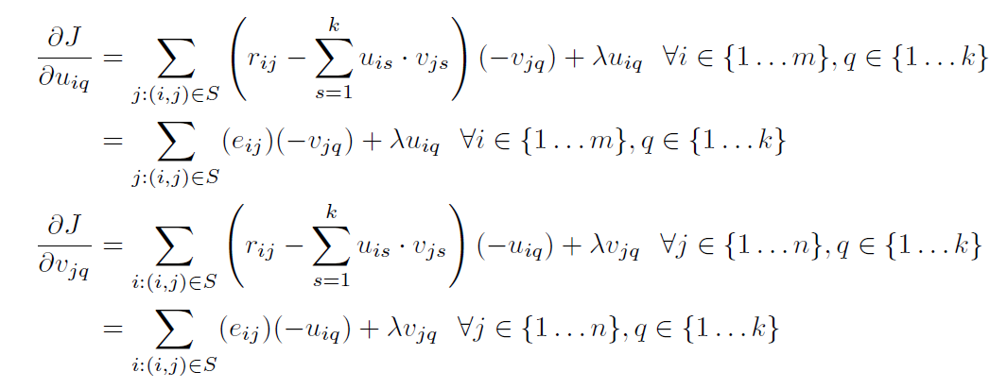
Regularization

Slide 47
Item
Initial guess
1 | 2 | ? | 1
? | 2 | 0 | ?
2 | 3 | ? | 1
? | 5 | 2 | ?
2 | ? | 4 | 0
1 | 1
1 | 1
1 | 1
1 | 1
1 | 1
1 | 1 | 1 | 1
1 | 1 | 1 | 1
User
V^{T}
U
+λ*u₁₁
+0.1*1
α=0.01 => step size=2*0.01=0.02
u₁₁ <= 1-0.02=0.98

Slide 48
Summary
The collaborative filtering problem can be viewed as a generalization of the problem of classification.
Therefore, many of the models that apply to classification also apply to collaborative filtering with some generalization.
latent factor models
Latent factor models are the state-of-the-art in collaborative filtering
Latent factor models use different types of factorization in order to predict ratings. These different types of factorization differ in the nature of their objective functions and the constraints on their basis matrices.
The method mentioned in the slides
Adv :Highest quality solution, Good for most matrices, regularization prevents overfitting
Disadv :Poor interpretability

